Slide 1

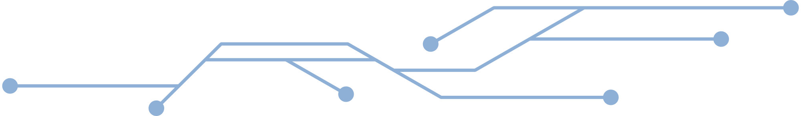

An Explainable Optimised Stacking Ensemble Framework
for Heart Attack Prediction: Reproduction
and Enhancement of a Machine Learning Approach
Student Name: Nafis Hasnat
Student ID: 226455731
Unit: SIT720 Machine Learning
Assessment: Task 11.1HD

Slide 2

Research Background & Objectives
Background:
  Cardiovascular disease is a major global health challenge.
  Machine learning can support early heart disease prediction.
  Ensemble models provide strong predictive performance.
Objectives:
  Reproduce a published stacking ensemble framework.
  Critically analyse its reliability.
  Develop an improved explainable stacking framework.

Slide 3

Reproduction of Published Research
Selected Research Paper: An efficient stacking-based ensemble technique
for early heart attack prediction(Bhagat et al., 2025)
Original Framework:
Dataset:
  Heart disease dataset
  1,025 patient records
  13 clinical features
Reproduction Objective:
  Implement the published stacking ensemble framework.
  Evaluate whether the reported performance can be reproduced.
  Analyse dataset quality and model reliability.
6 ML Classifiers
↓
Stacking Ensemble
↓
Heart Attack Prediction
Base Machine Learning Models:
  Logistic Regression
  Decision Tree
  Random Forest
  XGBoost
  Naive Bayes
  K-Nearest Neighbours

Slide 4
Dataset Quality Analysis and Reproduction Findings
Dataset Investigation:
Reproduction Result:
Original Dataset Accuracy: 100%
↓
After Duplicate Removal
More realistic evaluation
↓
Performance decreased
Heart Disease Dataset:
  1,025 Records
  13 Clinical Features
Duplicate Records Identified:
  723 Duplicate Samples
Clean Dataset:
  302 Unique Patient Records
Key Finding:
Duplicate records can lead to overestimated machine learning performance.

Slide 5
Proposed Optimised Stacking Ensemble Framework
Original Heart Disease Dataset
↓
Duplicate Removal
↓
Unique Dataset
↓
Feature Importance Analysis
↓
Feature Selection
↓
Hyperparameter Optimisation
↓
Optimised Stacking Ensemble
↓
Performance Evaluation
↓
SHAP Explainability
Key Improvements Over Original Approach:
  Data quality validation
  Feature-based optimisation
  Hyperparameter tuning
  Explainable AI integration
Original Approach: | Proposed Framework:
Stacking ensemble | Optimised stacking ensemble
Original dataset | Duplicate-free dataset
Performance focused | Performance + reliability + explainability
No SHAP analysis | SHAP-based interpretation
Main Contribution:
A reliable and interpretable stacking framework evaluated on a duplicate-free dataset.

Slide 6
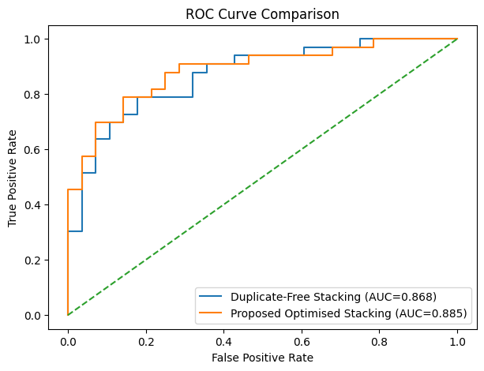
Experimental Results and Performance Evaluation
Model | Accuracy | F1-score | AUC
Duplicate-Free Stacking Baseline | 75.41% | 77.61% | 0.868
Proposed Optimised Stacking | 81.97% | 84.06% | 0.885
Improvement Achieved:
  Accuracy improvement: +6.56%
  F1-score improvement: +6.45%
  AUC improvement: 0.868 → 0.885
Key Result:
The proposed framework improved predictive performance while maintaining evaluation on a duplicate-free dataset.

Slide 7
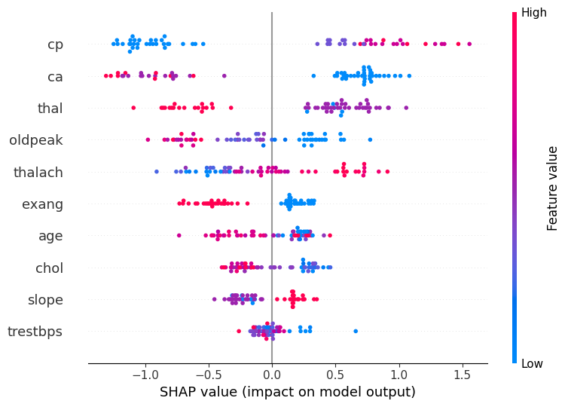
Explainable AI Analysis Using SHAP
SHAP Summary Plot: Feature Contributions:
Key Influential Features:
• cp — Chest pain type
• ca — Number of major vessels
• thal — Thalassemia indicator
• oldpeak — ST depression induced by exercise
• thalach — Maximum heart rate achieved
Key Finding:
SHAP analysis improves model transparency by explaining how clinical features influence heart attack predictions.

Slide 8

Conclusion and Key Contributions
Key Contributions:
Reproduced a published stacking ensemble framework
  Implemented the original heart attack prediction approach.
Identified dataset reliability issues
  Detected duplicate records affecting model evaluation.
Developed an optimised stacking framework
  Integrated data validation, feature selection, and hyperparameter optimisation.
Improved predictive performance
  Achieved better results on a duplicate-free dataset.
Integrated SHAP explainability
  Provided interpretable insights into clinical feature contributions.
Reliable healthcare machine learning requires not only high predictive performance, but also trustworthy data evaluation and model interpretability.
Thank You

